Slide 1
Unit 2 - Brief 1 / Week 3
Positions Through Iterating
Identity and Maps

Slide 2
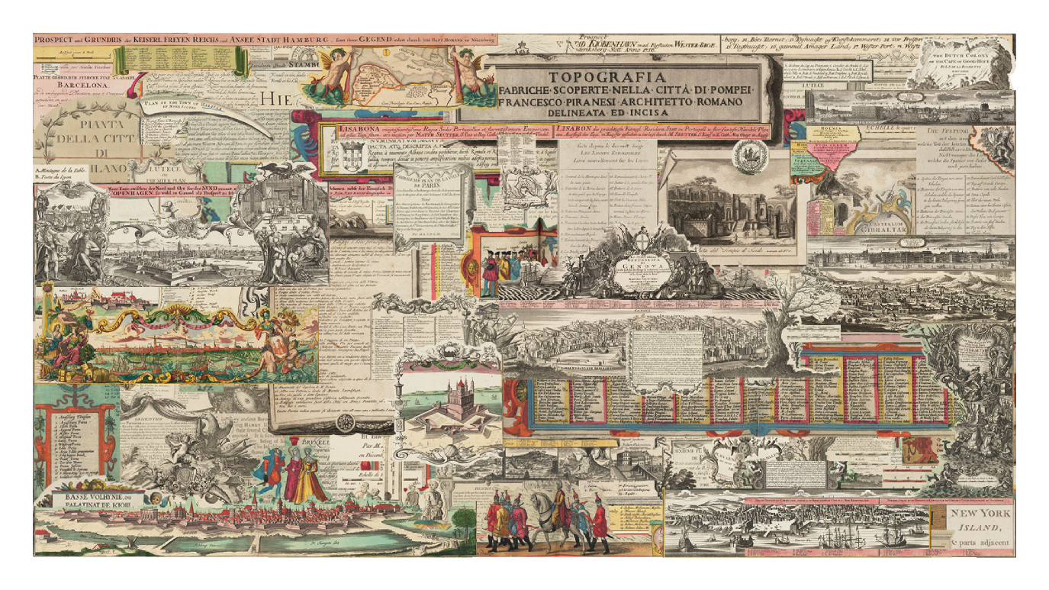
Initial Explorations
The Decolonised Map: A Map Without Borders
Notes:
I chose this project as the one that I wanted to replicate.

Slide 3
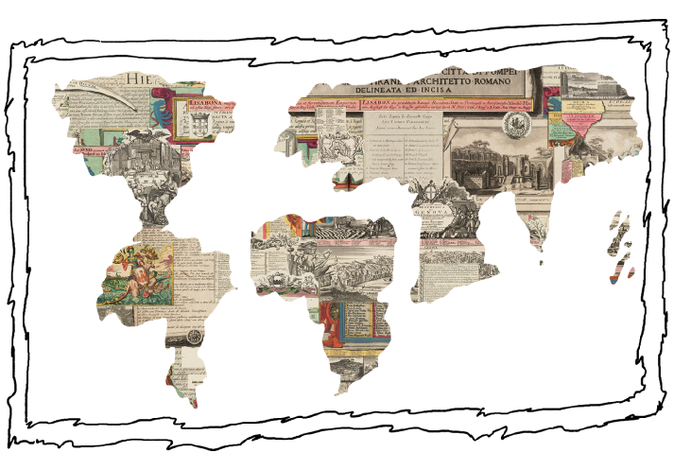
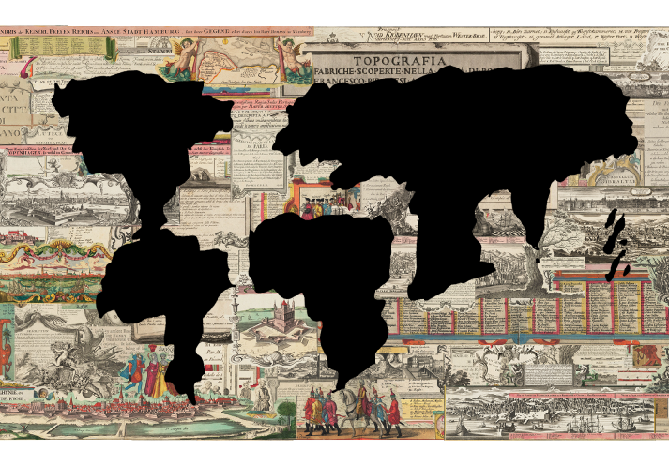
Initial Explorations
Alternate approaches
Drew the world map from my memory during the process and felt like it was an approach that wasn’t fully explored
Notes:
I chose this project as the one that I wanted to replicate.

Slide 4
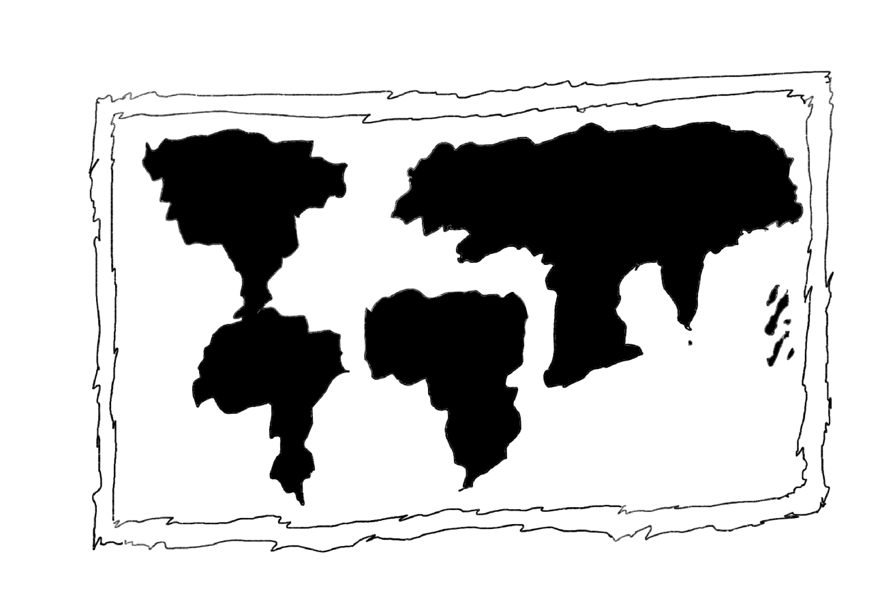
Snap-Shot (Iteration 0)

Slide 5
🥁🥁🥁🥁🥁
100 iterations of the World Map
through my memory
Notes:
?

Slide 6
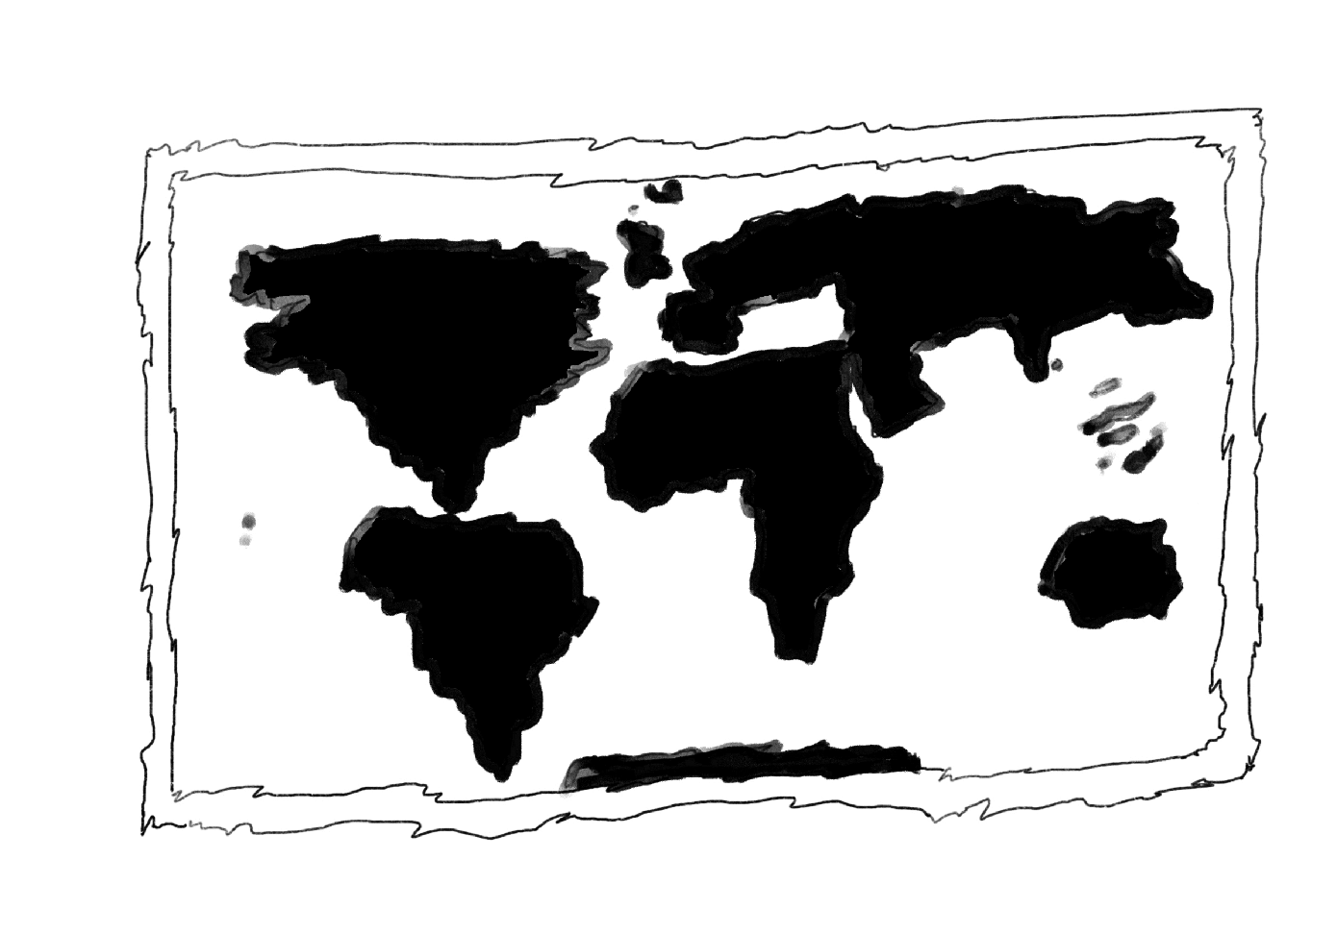

Slide 7
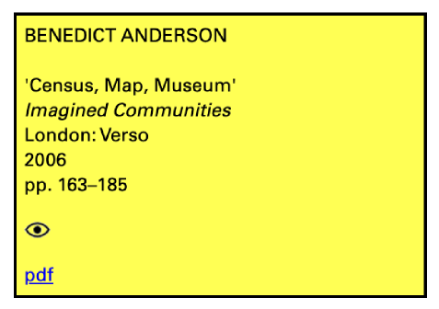
References
From the Reading List / Situating my project in a broader discourse
Census, Map, Museum - Benedict Anderson
In the chapter Census, Map, Museum from Imagined Communities, Benedict Anderson explores how colonial powers used tools like censuses, maps, and museums to categorize populations, define territorial boundaries, and construct national identities. He argues that these instruments were central to shaping the modern idea of the nation-state, embedding administrative control into the very imagination of communities. Through them, abstractions like "nation" and "people" became tangible realities.
Colonial authorities retained control of the colonised lands through borders and it made administration easier for them.
With respects to maps - it mentions how borders actually helped their cause and lead to an influence on cartography which is very imminent in the way that we look at maps in the modern day and age.

Slide 8
Enquiry
Initial Questions
Understanding of Space / envisioning maps
Questioning my understanding the world
Questioning (the absurdity) borders in itself / Big blobs of land mass
How the iterations influenced my understanding of the map (in terms of precision)
Why I kinda knew some places well, while the rest were kinda... (Asia-Africa, Morocco, Japan, East Indies, UK, Australia, the bulge of South America, Russia-Asia, Greenland)
Broadly, I was exploring my identity as an individual with the territorial border mappings that we find on the modern map and how they have shaped my perception of the world that I live in.

Slide 9
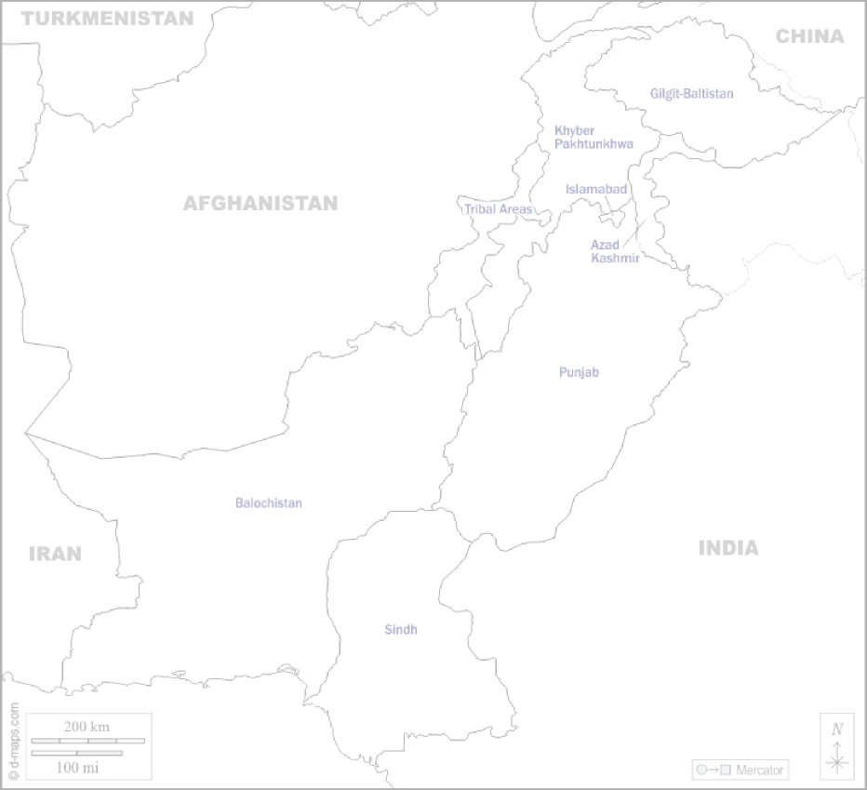
Who am I?
(Explained Through a Map)

Slide 10


Slide 11
My Identity
From an inter-sectional lens
Pakistani
Muslim
Pashtun
Male

Slide 12
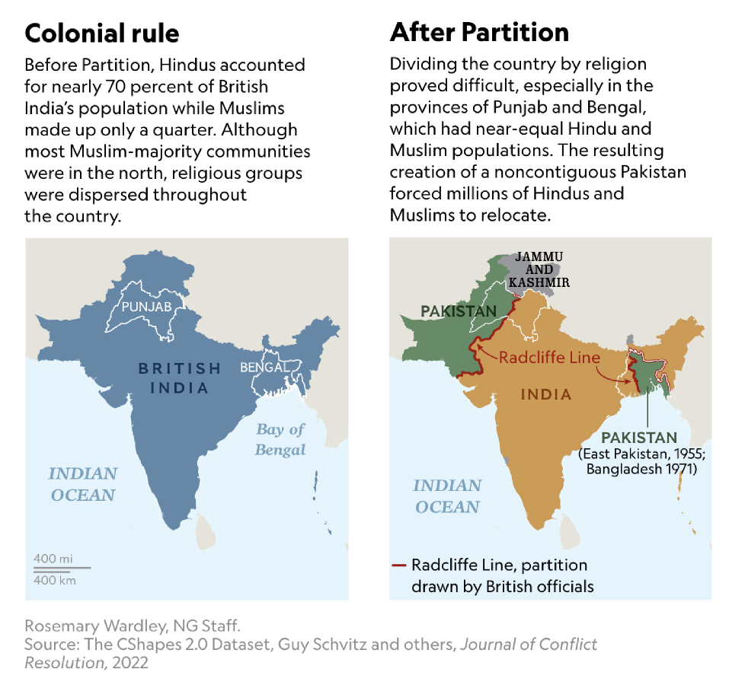
Small History Lesson
Indo-Pak Partition 1947

Slide 13
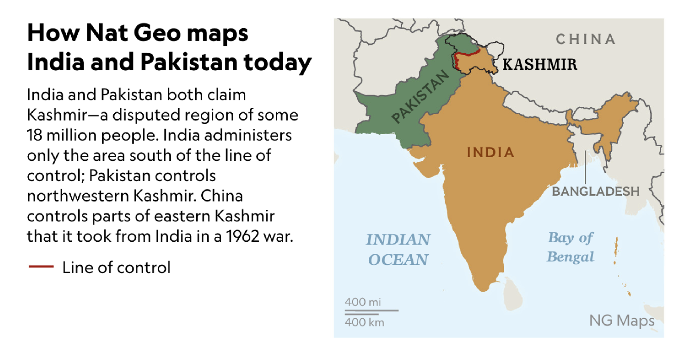

Slide 14
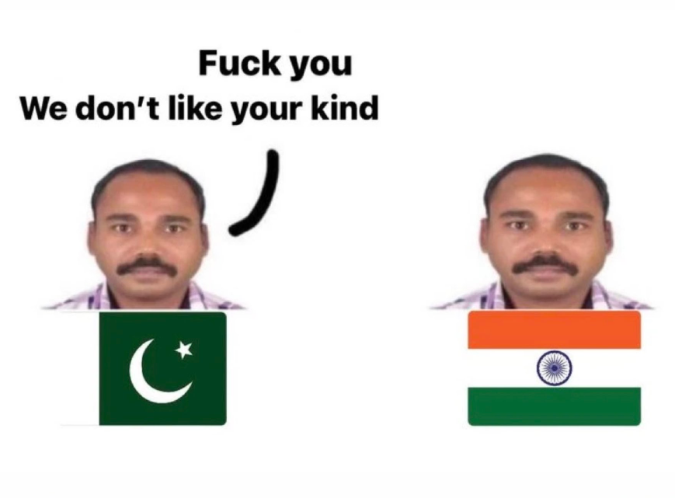
Pakistan India Wars 🇵🇰🇮🇳
1947–48: First Kashmir War ➔ ended in UN ceasefire.
1965: Second Kashmir War ➔ stalemate; Tashkent Agreement.
1971: War ➔ resulted in Bangladesh’s creation.
1999: Kargil Conflict ➔ India recaptured strategic posts.
Siachen Conflict (since 1984) ➔ highest battlefield on earth.
Frequent LoC skirmishes ➔ especially post-2000.
2019: Balakot airstrikes ➔ aerial dogfights after Pulwama attack.
Nuances in the Relationship 🤝
Shared Art & Culture ➔ Bollywood films, Pakistani dramas, and musicians (e.g., Atif Aslam, Rahat Fateh Ali Khan) are hugely popular across borders.
Common Languages ➔ Hindi and Urdu are mutually intelligible; Punjabi and Sindhi communities share linguistic roots.
Folklore & Traditions ➔ Folk tales like Heer Ranjha and Sassi Punnun are celebrated on both sides.
People-to-People Sentiment ➔ Despite political tensions, there is mutual admiration in sports, music, food, and literature.

Slide 15
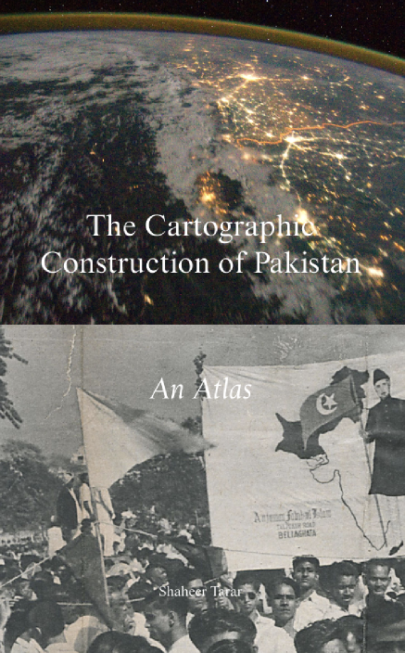
References
From outside the reading list / Subject Matter
The Cartographic Construction of Pakistan - An Atlas
The Cartographic Construction of Pakistan by Shaheer Tarar is an atlas that examines how maps were instrumental in shaping the borders and national identities during the Partition of British India. Through archival research and critical cartography, the work highlights how territorial lines drawn hastily by colonial powers continue to impact South Asia today. It also explores how maps, often seen as neutral, were—and still are—powerful tools of politics and ideology.

Slide 16
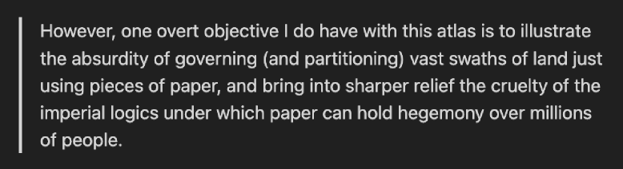
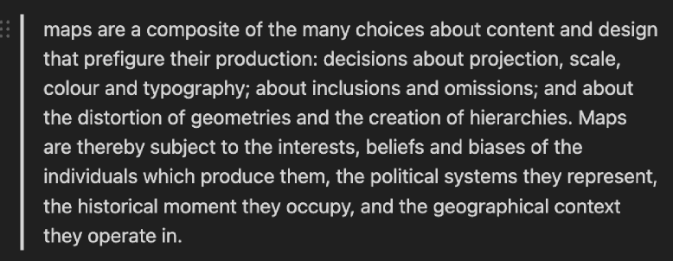
The Cartographic Construction of Pakistan - An Atlas
Allowed me to think about relatively implicit and power-less tools and mediums like “paper and lines” and mapping the influence of these “power-less” objects on a much more tangible scale over actual populations.
Maps are instruments of power. Their is intention behind them and the are a key segway between nationalism and the accumulation of different groups into state-hood.
Allowed me to reflect on how I perceive my identity as mixed with me listening to punjabi music / liking sindhi fabrics / urdu poetry / balochi fashion while being ethnically pashtun is a manifestation of that idea.

Slide 17
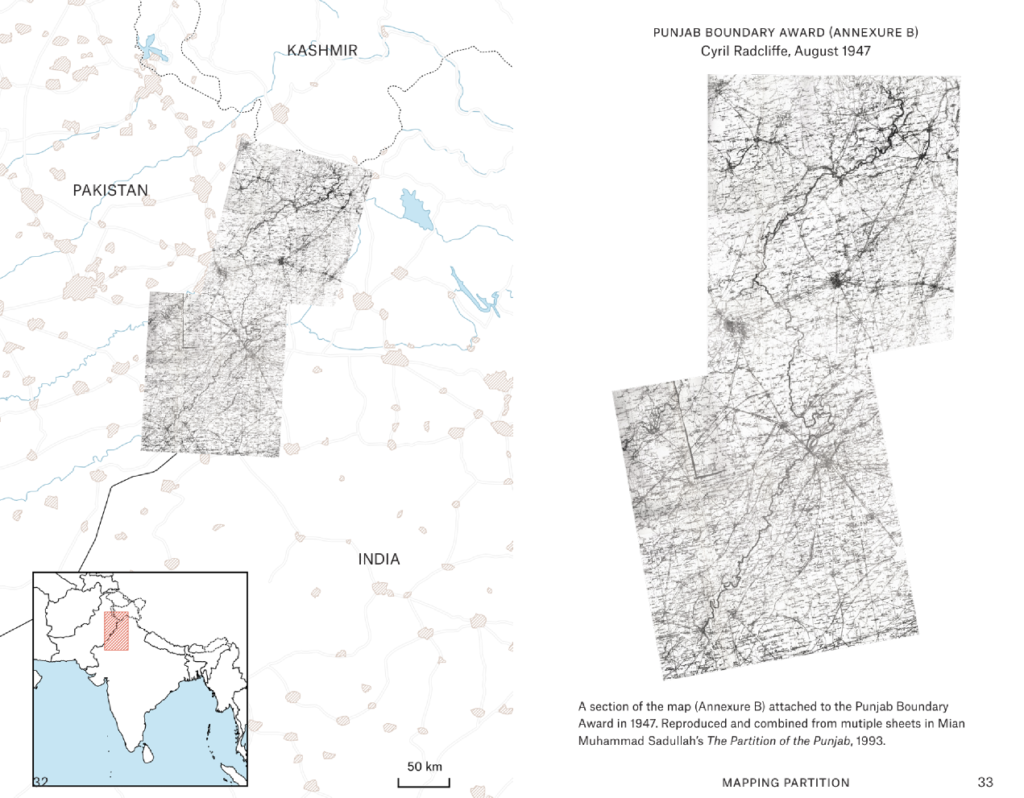

Slide 18

Identity
Territorial Maps
State-hood
How it helped my Enquiry?
Macro → Micro (later informed my making)
What is my understanding of self in contrast to the maps that I grew up around and how they are a marker of my identity? I am trying to questioning the rigidity of borders while also exploring their role in a post colonial world.
Decolonisation - how maps can be a form of protest in a post colonial world?

Slide 19
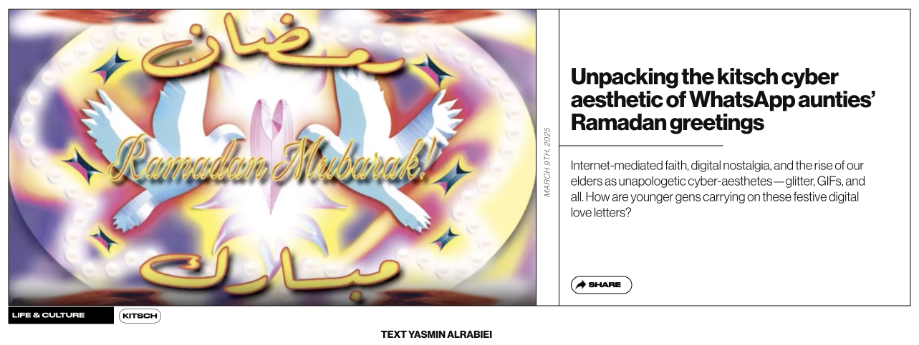
References
From outside the reading list / Making or the Method
How it helped my Enquiry?
Unpacking the kitsch cyber aesthetic of WhatsApp aunties’ Ramadan greetings
This Dazed article examines how the kitschy cyber-aesthetic of WhatsApp Ramadan greetings resists Western digital minimalism, preserving a culturally rooted, decolonial form of visual expression shaped by community and faith.

Slide 20
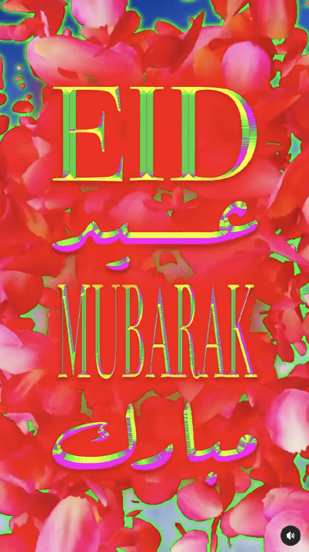
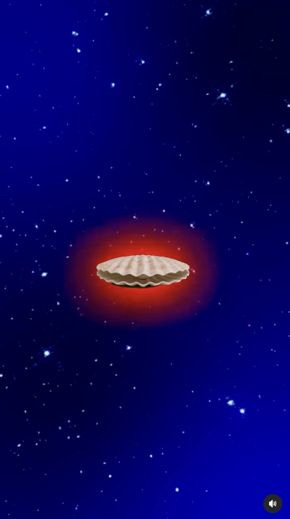
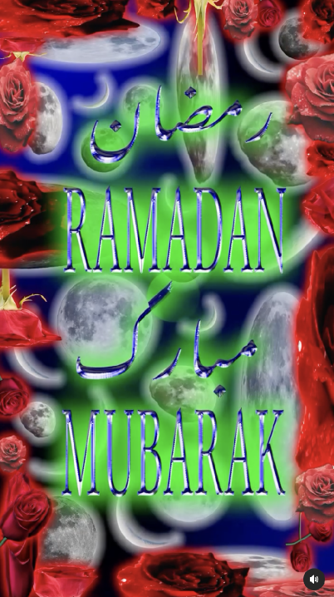
References
From outside the reading list
Eid Mubarak Animation
Ramadan Mubarak Animation
Ramadan Mubarak Animation

Slide 21
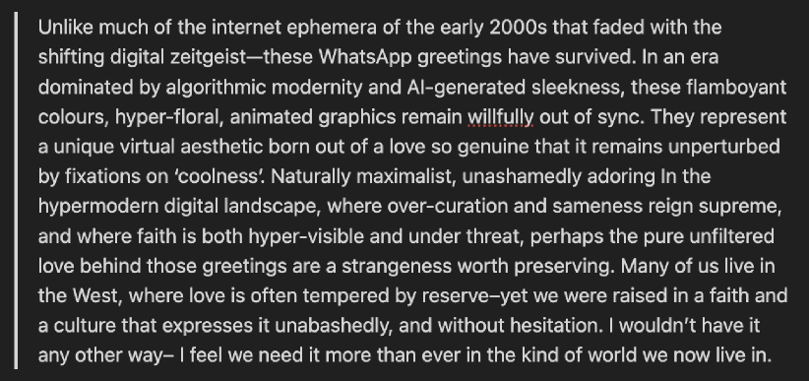
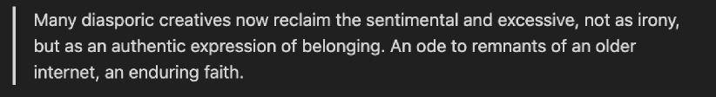
References
From outside the reading list
De-colonial angle here; Something about the need to preserve an aesthetic that defies global conventions and trends. Something that isn’t tempered by reserve. Encourage a counter-cultural approach that I am trying to explore as well.
Since a big part of my enquiry is identity, this nudged me in the direction of authenticity and the idea of staying true to yourselves. And feeling self-assured about it. I am a lover at heart, unapologetically. Something about the nonchalance, loudness and purity of these visuals really spoke to me.

Slide 22
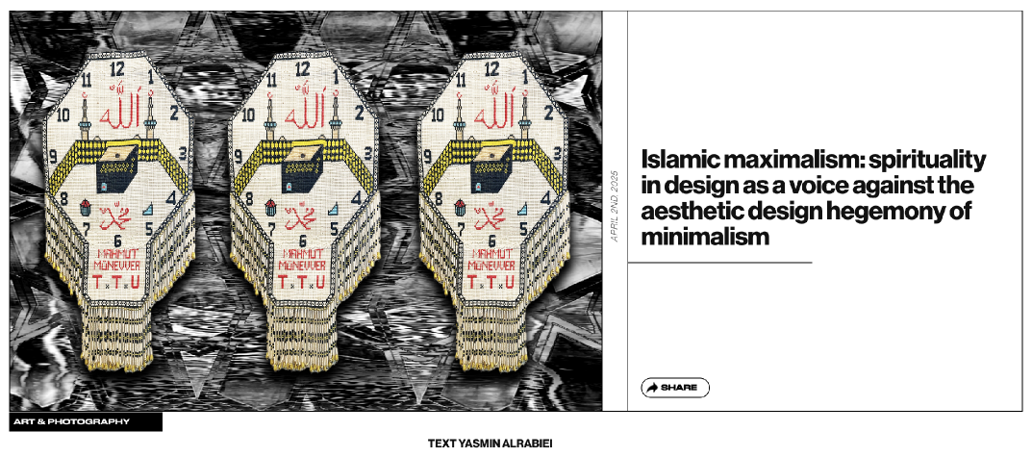
References
From outside the reading list / Critical Position
Islamic maximalism: Spirituality in design as a voice against the aesthetic design hegemony of minimalism
This article from Dazed explores how Islamic maximalism offers a spiritual and culturally rich alternative to the dominant minimalist design aesthetic, challenging Western-centric ideas of beauty and visual order.

Slide 23
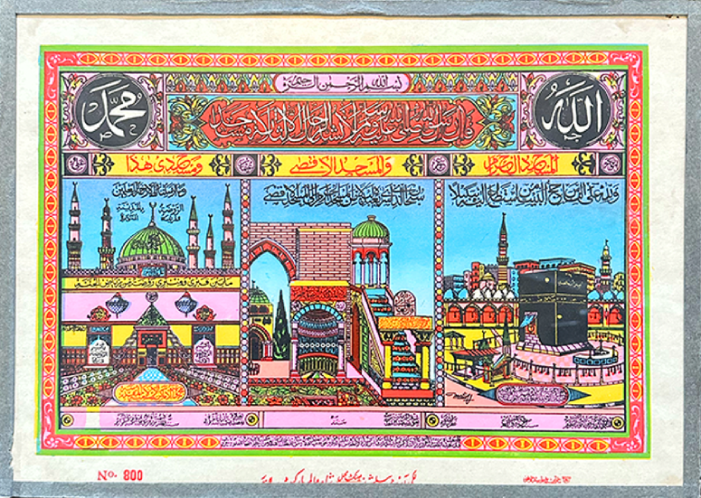
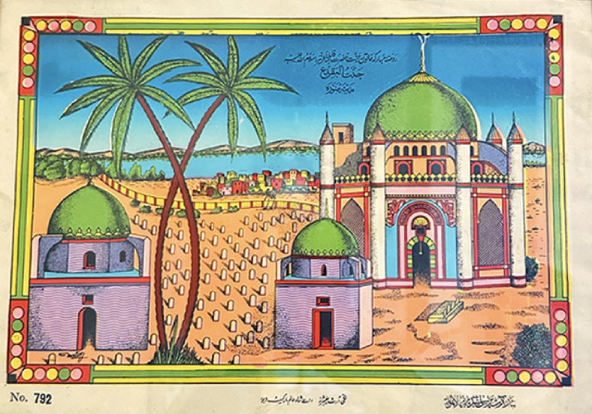
References
From outside the reading list
Vintage Framed Posters of Holy Islamic sites

Slide 24
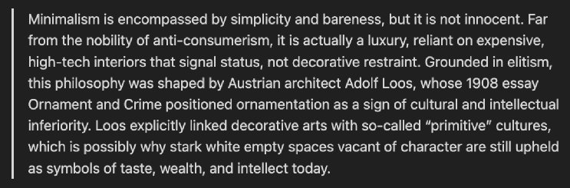
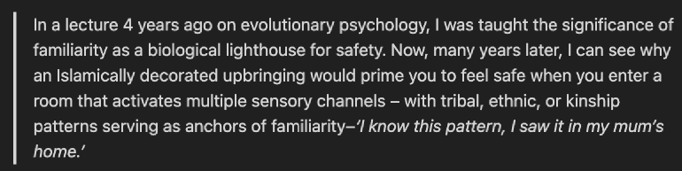
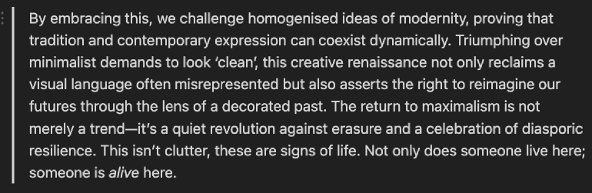
References
From outside the reading list
This just really stood out. The thing about familiarity. Made me think of how I was conditioned through familiarisation of the modern world map (including that of Pakistan) since a very young age. Hence my identity almost feels inseparable from the confines of the territorial map of Pakistan.
Colonisation is what forces you to adopt things that aren’t necessarily inherent to you. And the adoption of Islamic maximalism in a Gen-Z population is a counter culture of sorts that encourages reclamation of heritage, indigenous-ness and whats familiar; hence decolonisation.
The pushback against minimalism through these methods of making is an active process of decolonisation. Its a revolution against the erasure of indigenous identities in a highly globalised world that forces you to conform to the mainstream minimalist narrative

Slide 25
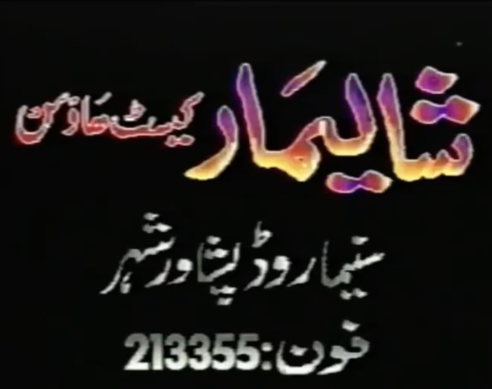
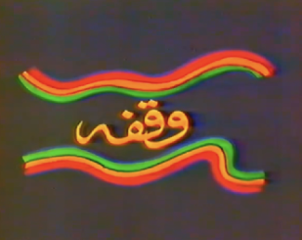
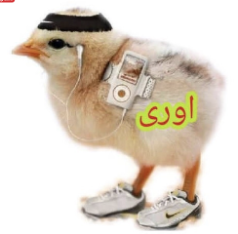
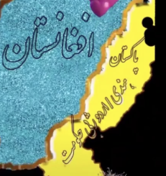
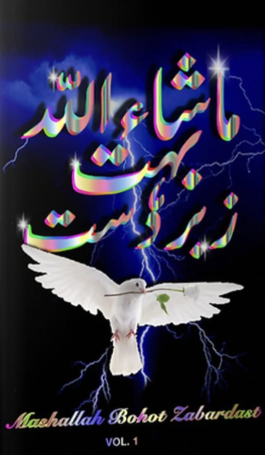
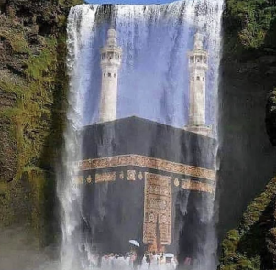
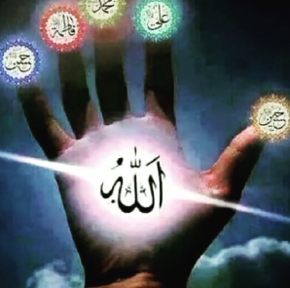
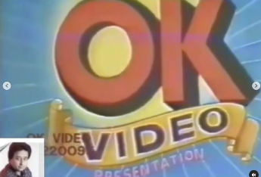
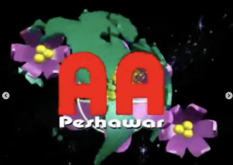
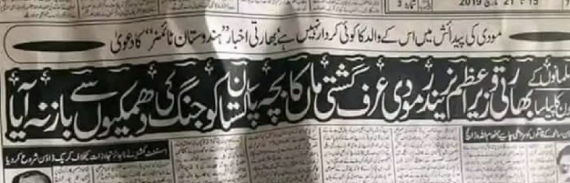
Similarity w/ Pakistan

Slide 26
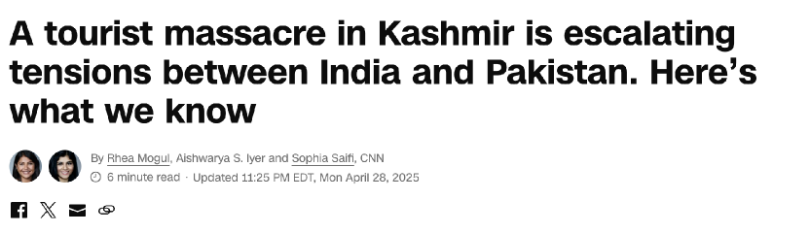
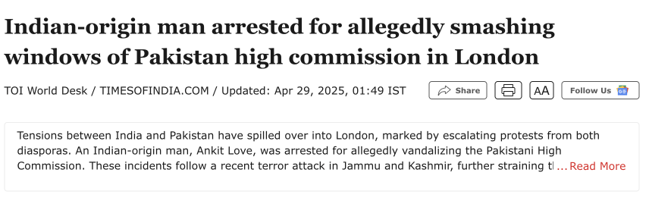
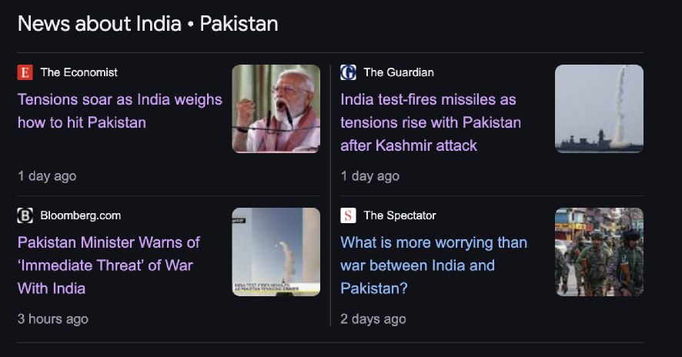
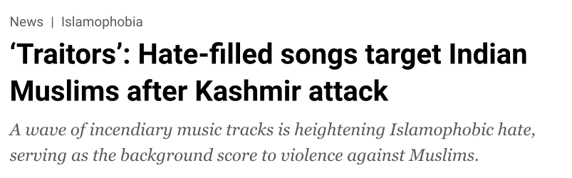
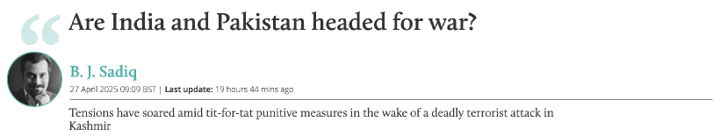
Current Circumstances
War Tensions b/w India and Pakistan

Slide 27
🥁🥁🥁🥁🥁
Pakistan-India border
drawn from my memory
Notes:
?

Slide 28
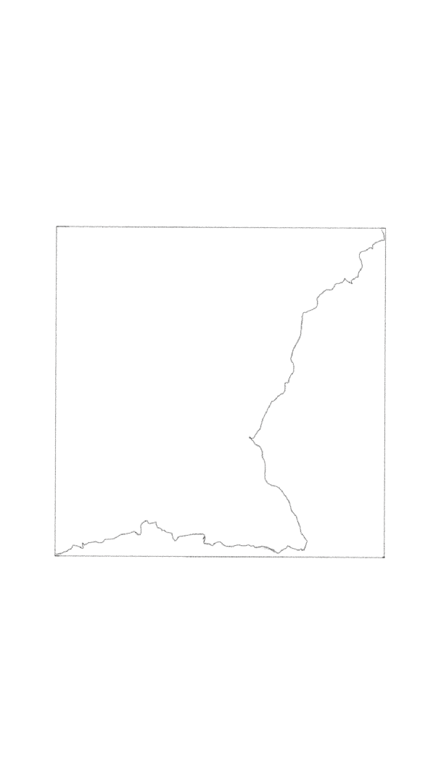

Slide 29
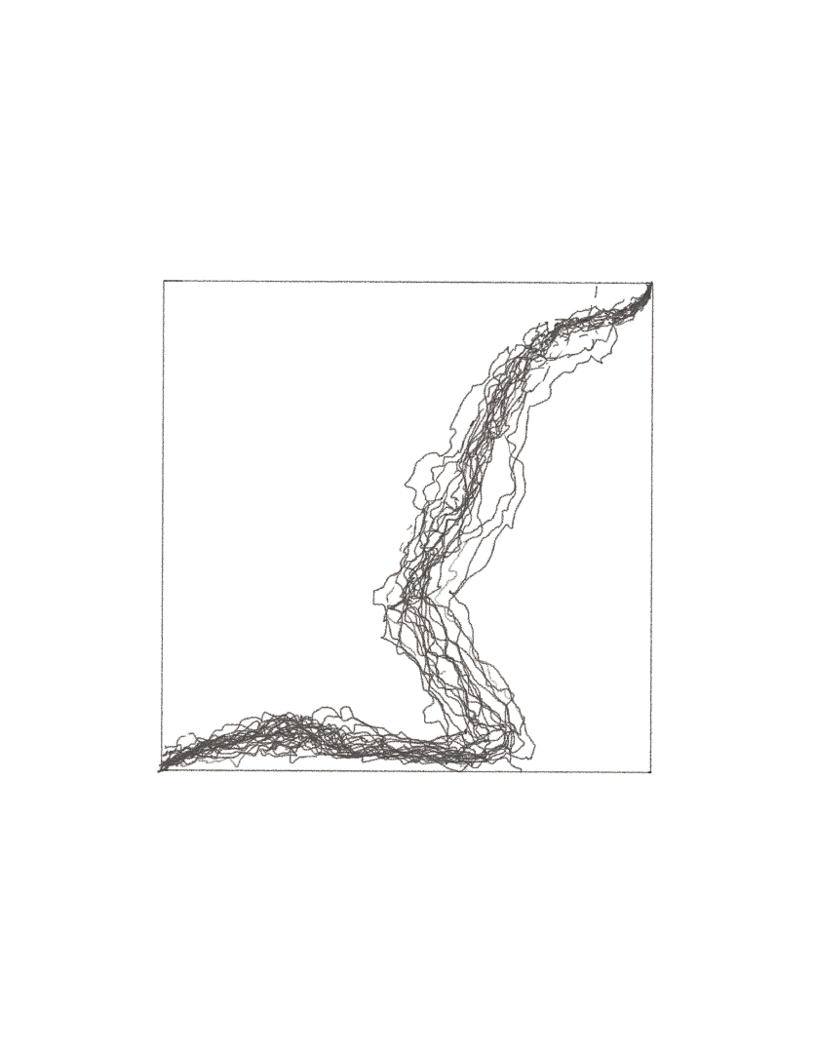

Slide 30
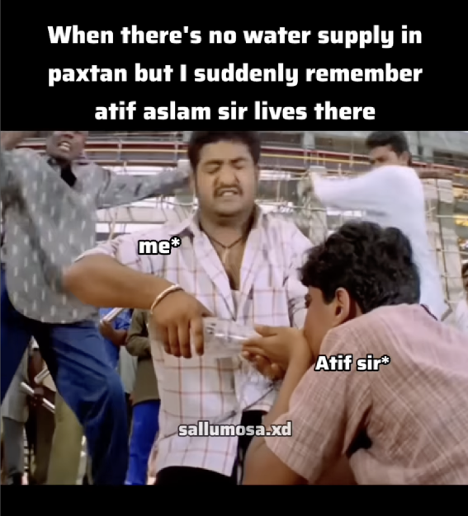
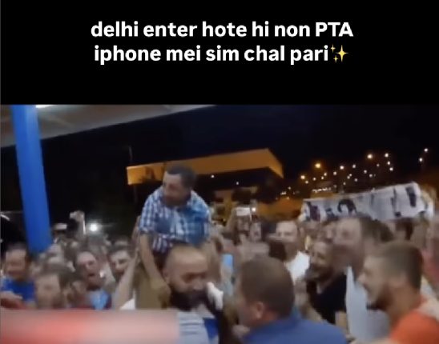
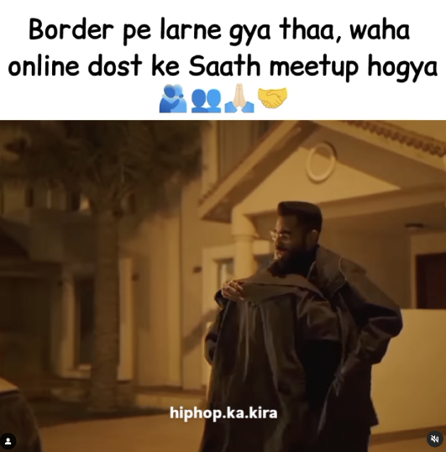
Meme-War
War Tensions b/w India and Pakistan
Sim card functional now
(Bro)der meet-up
Atif Aslam

Slide 31
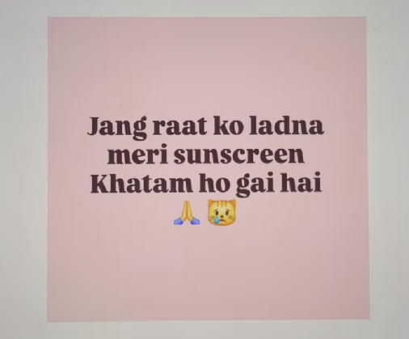
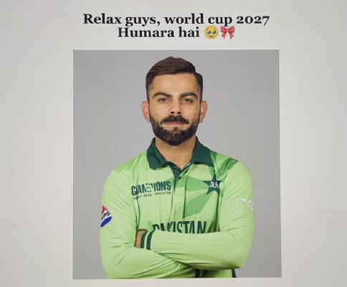
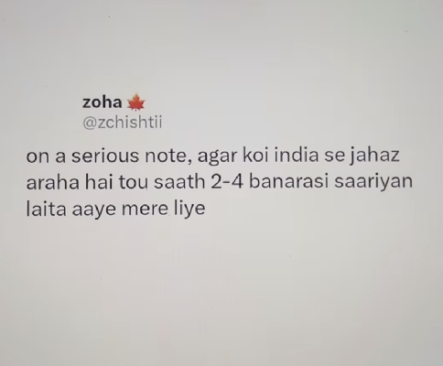
Meme-War
War Tensions b/w India and Pakistan
“Please arrange for the war to happen at night, I am out of sunscreen atm”
Virat Kohli - A legendary Indian Cricketer being photosopped in a Pakistani Cricket Team jersey Text: “Relax guys, we are winning the 2027 cricket worldcup
“On a serious note, if there are any warplanes coming over from India, please bring 204 Banarasi Saris with you”

Slide 32
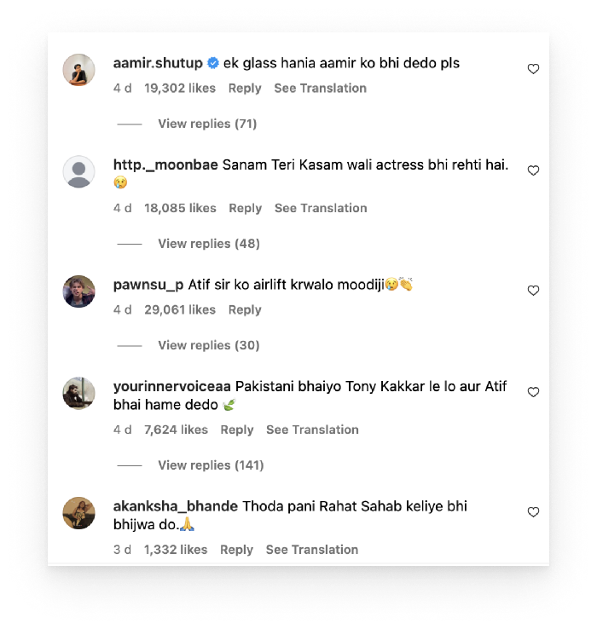




Nostalgia
“Give water to my favv celebrity”
“Lets Meet-up on the border”

Slide 33



Making
Ornating the border
Fuck off War (L to R: Urdu, English, Hindi)

Slide 34



Making
Ornating the border
Love (Urdu)
I h8 war
vry nic deer

Slide 35


Making
Ornating the border
Water Wars ”India please give me water, i have soap in my eyes”
War postponed due to bad weather ”Who even has a war in this terrible summer?”

Slide 36


Enquiry
Further Questions

Slide 37
“Are we fighting a war or
are we making amends?”

Slide 38
Enquiry
Further Questions
Personal Identity → Holistic Outlook
The relationship of humor with the erasure of borders (metaphorically)
People - people connection in digital spaces and its relationship with borders
Humor as an anti-propaganda tool
Humor as a propaganda tool - portraying a softer image of yourself
Democratization of media and how it has influenced the idea of borders
My identity as an artist and how I situate myself in moments of conflict in a geopolitical landscape and how can I respond to situations like these

Slide 39


Shout-out
Map: Exploring The World

Slide 40
🌹
شکر یہ | धन्यवाद
(“Thank you” in Hindi and Urdu)

